Slide 1
Beyond the Public Mempool: Catching DeFi Attacks Before They Happen with Real-Time Smart Contract Analysis
Speaker:
Bahareh Parhizkari (University of Luxembourg)
Co Authors:
Antonio Ken Iannillo (University of Luxembourg), Christof Ferreira Torres (ETH Zurich), Joseph Xu (Quantstamp), Sebastian Banescu (Quantstamp), Radu State (University of Luxembourg)
Conference: Securecomm, 28-30 October 2024
Notes:
Thanks for coming to my presentation
I’m presenting my paper titled …

Slide 2
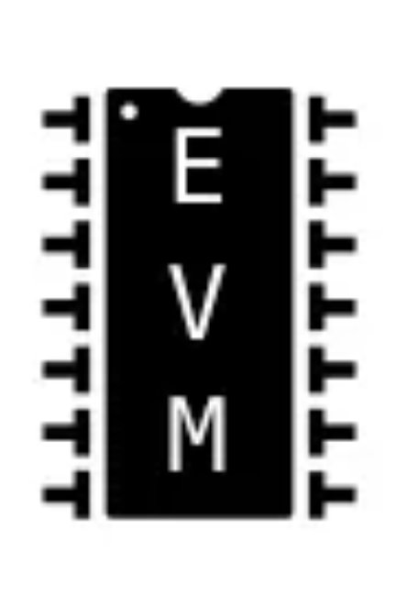
Introduction
Ethereum is a blockchain platform that enables the execution of smart contracts, offering a wide range of applications beyond cryptocurrency
At the core of Ethereum is the Ethereum Virtual Machine (EVM), a runtime environment that executes smart contracts.
Smart contracts are represented as bytecode, a low-level representation of the contract’s code.
Transactions in Ethereum are messages EOAs send to interact with another account, including EOAs and smart contracts. Transactions are stored in mempool before being executed.
Notes:
This background shows the need for identifying

Slide 3
Introduction
Decentralized Finance, or DeFi, refers to financial services and applications built on blockchain technology, including decentralized exchanges (DEXs), lending and borrowing platforms, yield farming, and more.
DeFi projects are not without risks
Attackers actively seek vulnerabilities in smart contracts to exploit and launch attacks, including Reentrancy, Flash Loan attacks, and Oracle attacks.
Malicious smart contract is a smart contract that contains specific instructions or conditions, also called attack payload, that leads to an exploit when triggered.
Notes:
This background shows the need for identifying

Slide 4
Motivation
Current DeFi Attack Detection Gaps:
Most current attack detection tools monitor the public mempool to detect suspicious transactions.
However, attackers now use private pools (such as Flashbots), which bypass public monitoring tools and hide malicious transactions until the moment of attack execution.
Main Idea of this research:
Detect malicious smart contracts during the malicious smart contract deployment phase rather than after an attack is executed.
Immunefi’s Reports: https://immunefi.com/research
Notes:
Slide 3: Motivation
DeFi Vulnerabilities: Smart Contracts:

Slide 5
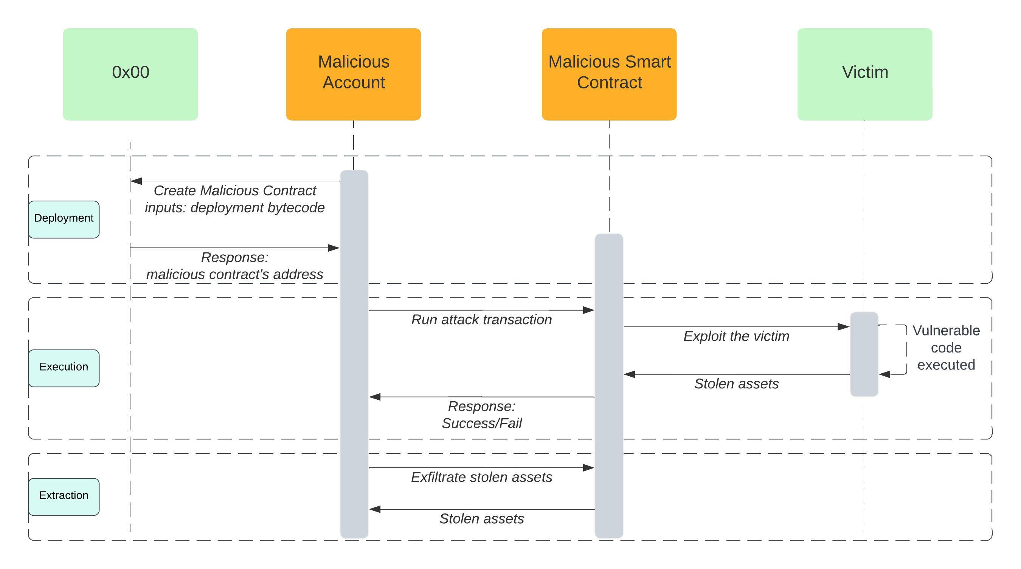
The Attack Lifecycle
We focus on this stage to detect
and stop the attack’s process.
Notes:
Stages of Attack:
Deployment: Attack contract is deployed.
Execution: Malicious contract interacts with vulnerable contracts.
Extraction: Attacker transfers stolen assets.
Rescue Window: Early detection at the contract deployment stage allows preemptive action before the actual attack begins.

Slide 6
Research Contributions
Novel Dataset:
Collected 161 malicious and 5,000 benign smart contracts.
Feature Extraction:
Introduced 465 unique features from smart contracts related to deployers, transaction characteristics, and bytecode.
Machine Learning Model:
Trained ML models to detect malicious contracts at deployment, outperforming the existing state-of-the-art solution(Forta ML Bot).
Immunefi’s Reports: https://immunefi.com/research

Slide 7
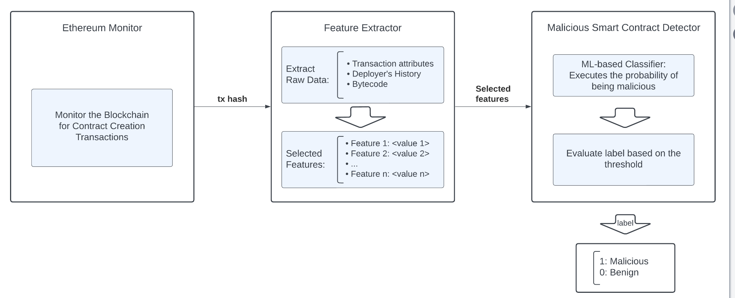
Model pipeline
Notes:
To answer this question, we introduced a methodology and we named it

Slide 8
Feature Extraction from Dataset
The study extracted 465 unique features from three main categories:
Deployment Bytecode Features:
Features based on the bytecode of the smart contracts.
Focus on attributes such as bytecode size, number of functions, and opcode frequencies.
Important for understanding the complexity and malicious payload of the contract.
Contract Deployment Transaction Features:
Analyzed details of the contract deployment transaction itself.
This includes Gas price, Transaction value, Gas used during deployment, etc.
These features reflect the behavior of the deployer at the time of deployment
Deployer Features:
Features related to the deployer’s history and behavior, including Deployer’s balance, transaction history, and deployer’s behavior.

Slide 9
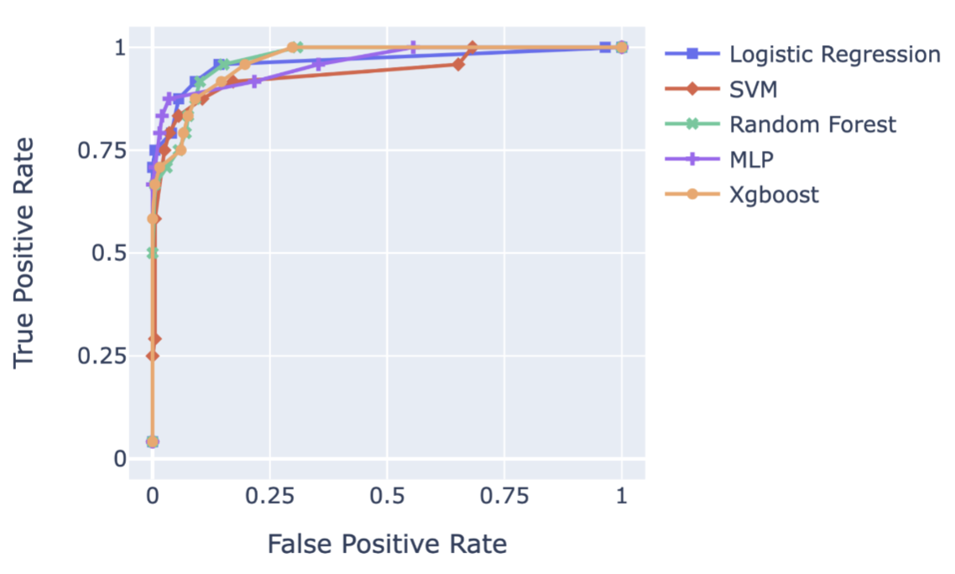
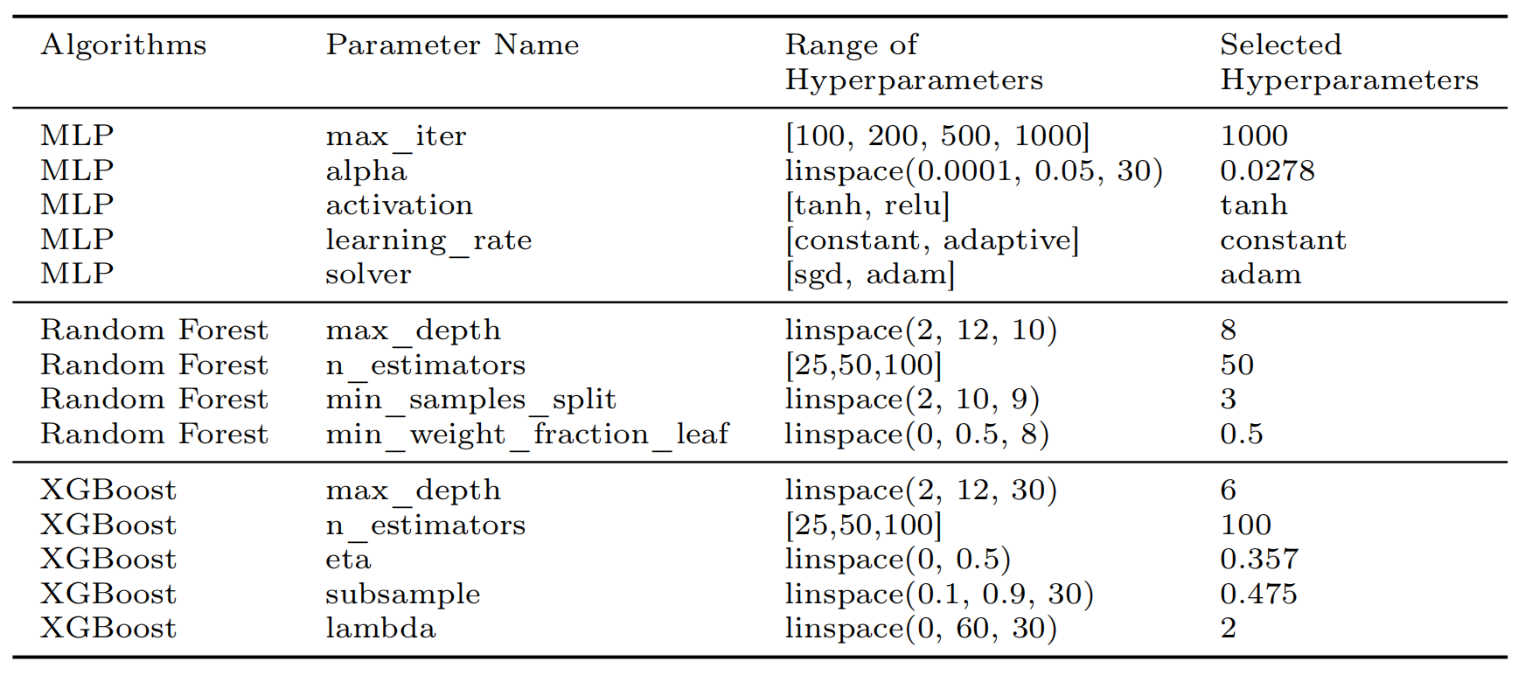
Evaluation: Machine Learning Methods and Models
1. Feature Selection
2. Model Evaluation and Comparision
3. Hyperparameter tuning
Notes:
Feature Selection: 465 features were reduced to 45 through feature selection methods.
Models Evaluated: Logistic Regression, SVM, Random Forest, XGBoost, and Multi-Layer Perceptron (MLP).
Best Model: MLP was found to have the best balance between True Positive Rate (79%) and False Positive Rate (<1.8%).

Slide 11
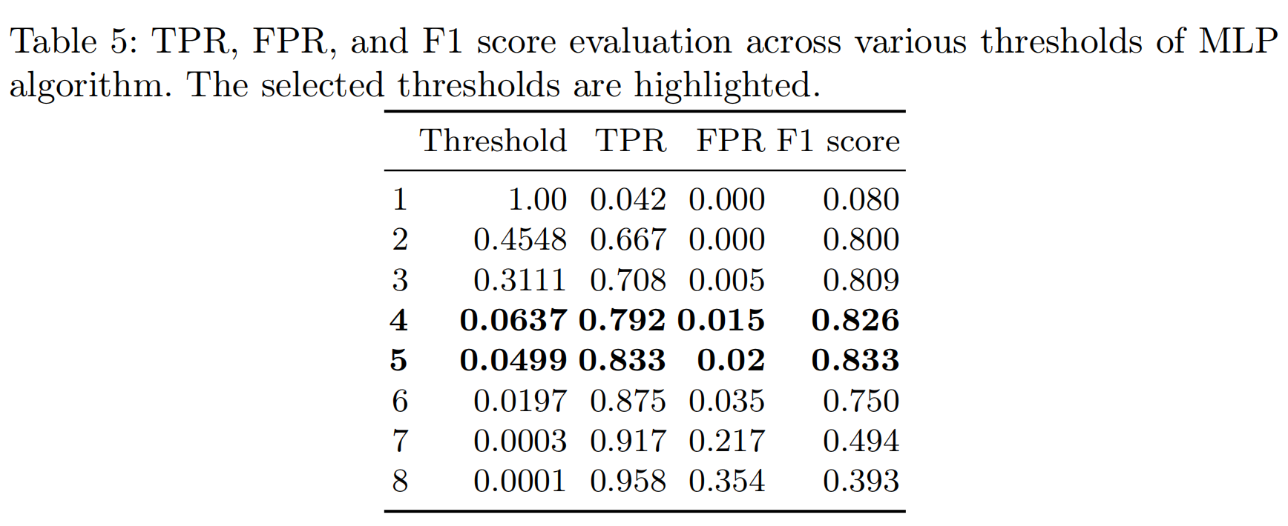
Evaluation and Results
Notes:
Detection Accuracy: The MLP model outperformed existing detection tools like Forta ML.
True Positive Rate (TPR): 79.17%
False Positive Rate (FPR): Less than 1.8%
Comparison with Forta ML Bot: MLP detects 21% more malicious smart contracts and generates fewer false positives.

Slide 12
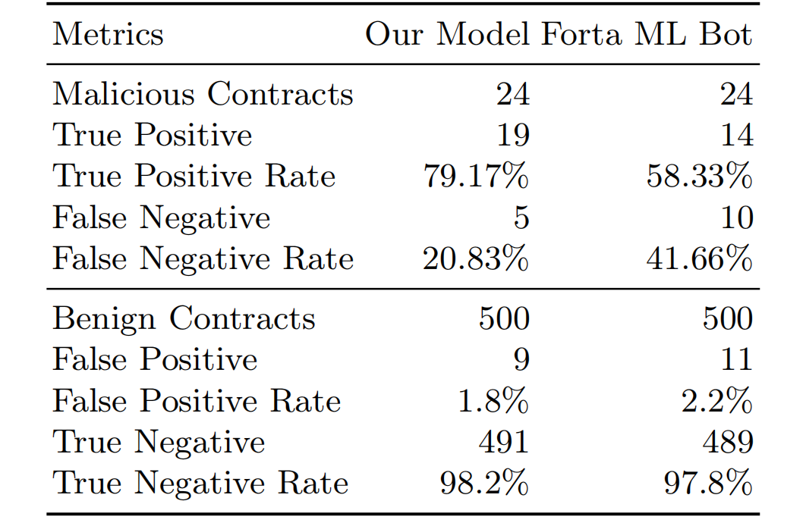
Comparision and Benchmarking
We evaluate the model against the state-of-the-art malicious smart contract detector bot(Forta ML)

Slide 13
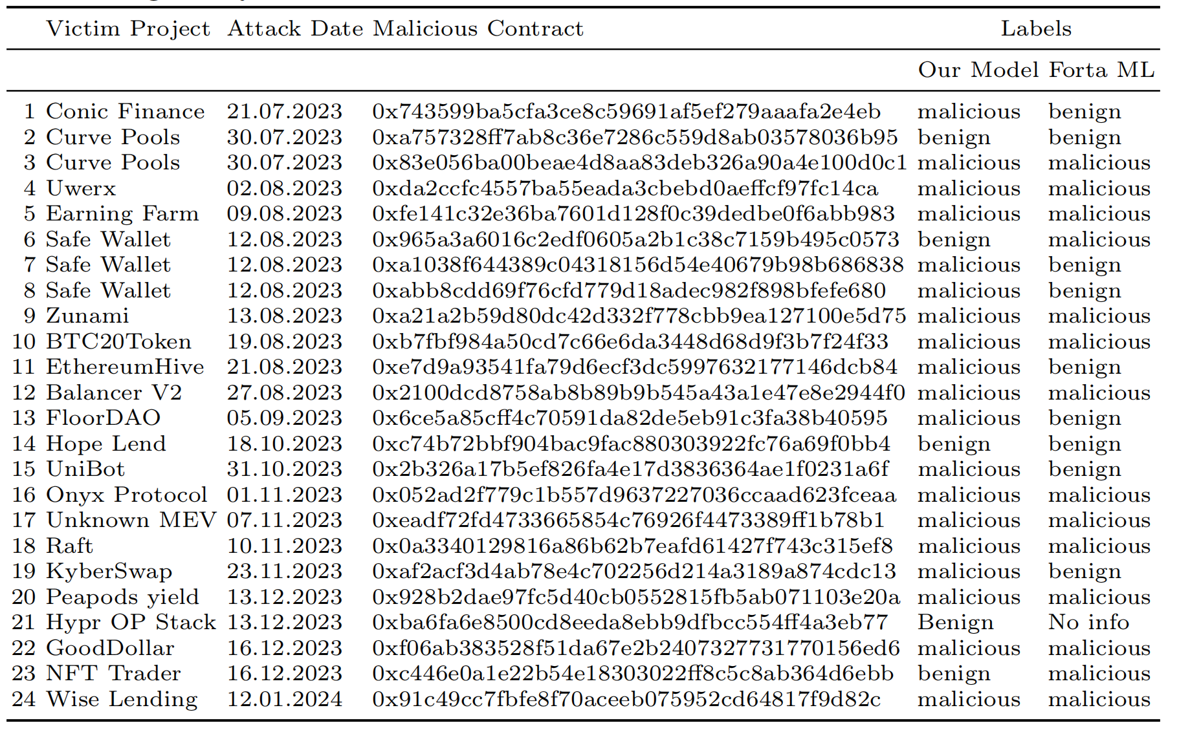
Comparision and Benchmarking
We evaluating the detection accuracy across 24 recent attacks by comparing labels assigned by our model and Forta ML bot.

Slide 14
Most impactful features
Notes:
Real-Time Detection: The model flags malicious contracts immediately after deployment.
Rescue Window: Offers time for countermeasures, such as pausing the protocol or blocking malicious contracts before they can cause damage.
Scalability: Handles Ethereum's high transaction volumes and could be extended to other chains like Polygon or Binance Smart Chain.

Slide 15
Practical Impacts
Real-Time Detection:
The model flags malicious contracts immediately after deployment.
Rescue Window:
Offers time for countermeasures, such as pausing the protocol or blocking malicious contracts before they can cause damage.
Scalability:
Handles Ethereum's high transaction volumes and could be extended to other chains like Polygon or Binance Smart Chain.
Notes:
Real-Time Detection: The model flags malicious contracts immediately after deployment.
Rescue Window: Offers time for countermeasures, such as pausing the protocol or blocking malicious contracts before they can cause damage.
Scalability: Handles Ethereum's high transaction volumes and could be extended to other chains like Polygon or Binance Smart Chain.

Slide 16
Conclusion
Early detection of malicious smart contracts is possible and highly beneficial.
The proposed model achieves high accuracy and provides a critical rescue window for DeFi protocols.
Future improvements could make DeFi ecosystems significantly safer from attacks.
Notes:
Key Takeaways:
Early detection of malicious smart contracts is possible and highly beneficial.
The proposed model achieves high accuracy and provides a critical rescue window for DeFi protocols.
Future improvements could make DeFi ecosystems significantly safer from attacks.
Questions Slide: Open the floor for any questions or discussion.

Slide 17
Thank you
Bahareh Parhizkari
Email: bahareh.parhizkari@uni.lu
Notes:
quantstamp-h.jpg

